Slide 1

Instructor: Ward Struthers

Slide 2
Relationships are important: Well-being
Happier (Myers, 2000)
Cope better (Abbey & Andrews, 1985)
Married couples have less heart disease and live longer(Alviar & Marshall, 2014; Myers, 2000)
Rejection leads to physical & social pain (MacDonald & Leary, 2005)

Slide 3

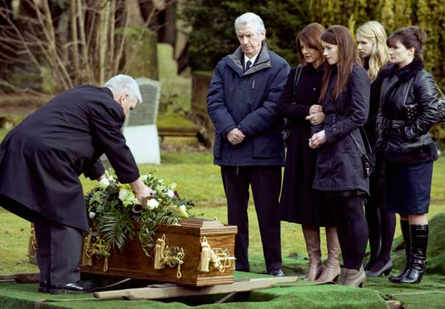
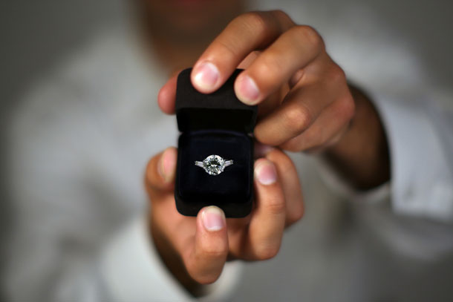

Relationships are important: Behavior
Individuals readily form relationships
9 out of 10 marry world wide
We celebrate social bonds
We mourn the loss of social bonds
We spend billions to attract others
How many hermits do you know?

Slide 4
Social Psychology: Lecture 1
Form Impressions
  Based on Inferences
  Based on Stereotypes

Slide 5
Social Psychology: Lecture 1
What kind of music do I like?
What are my favourite TV shows?
Do I like sports?
How old am I?
Am I married?
What radio stations do I listen to?
Do I play any musical instruments? (e.g.)
Do I use a Mac or PC?
Am I a vegetarian?
Am I an outdoorsy kind of person?

Slide 6
Social Psychology: Lecture 1
Social Psychology Defined:
  The scientific study of how people think about, influence, and relate to one another (Myers & Spencer, 2004)
  The study of how individual’s thoughts, feelings, and behaviours are influenced by the actual, imagined, and implied presence of others (Allport, 1985)

Slide 7
Social Psychology: Lecture 1
Social Psychology is the study of how individuals think about, relate to, and influence one another based on the actual, imagined, and implied presence of other individuals.

Slide 8
Social Psychology: Lecture 1
Important details of the course
  Syllabus
  My information
  TA information
  Attendance
  Exams/Grading
  Bonus points

Slide 9
Social Psychology: Lecture 1
Class Conduct
  Attendance
  Lateness, leaving early
  In-class discussion
  2120 not dinner theatre
  Texting, surfing, cell phones
  Exams (attendance, lateness, cheating)

